Slide 1
Infrastructure Automation with Terraform & Azure Devops on Azure cloud
Harshal Mittal

Slide 2
Deploy our first terraform configuration file. Section 2
Notes:
In this section we are going to deploy our first terraform configuration file.

Slide 3
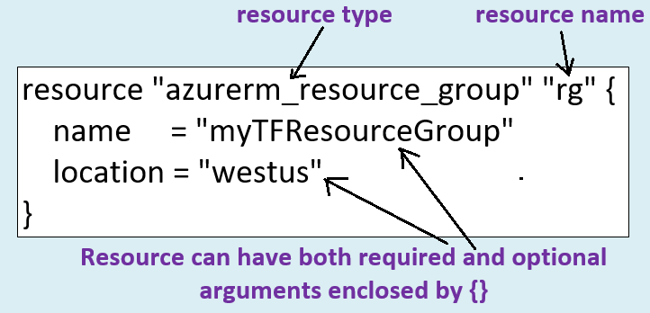
Terraform resources block overview
Notes:
A resource block defines the desired state for a given resource within the infrastructure.
A resource block has two string parameters before opening the block: the first parameter is resource type and the second parameter is resource name
The combination of the type and name must be unique in the configuration.
The following example uses a resource block to provision a new Azure resource group.
The resource name ”rg” is used to refer to the object created in the resource block throughout the configuration.
It is not the same as the name of the resource group in Azure.
Within the resource block enclosed by {} are the arguments for that resource.
Resources can have both required and optional arguments.
This example specifies name and location, both are the required fields to deploy a resource group.

Slide 4
Our first deployment
Notes:
This is the layout of our first terraform deployment.
In this deployment, I am going to deploy a resource group with the name Terra-rg
And 2 more resources with the same resource group the name remotesa01 a storage account
And kvult-01 as a key-vault, we are going to use these resources in our future labs.
so if you are following along then do this lab, and leave these resource deployed until you finish all other labs.
there is not much running cost involve in leave these resource deployed in the cloud.
You may come across an issue while deploying this lab, as the resource name are already taken so you can chose some alternative names as those resources need to have unique names across the Azure cloud.

Slide 5
Demo
Notes:
Let us start with this lab.

Slide 6
Terraform commands and first deployment overview
Next video
Notes:
This is end of section 2, in next section will learn more terraform commands to modify, taint and destroy resources. We will also learn more about terraform configuration file management.

